Slide 1
Text Analytics Assignment
Word Cloud, Word Frequency Count
Submitted by
Malathi M

Slide 2
BUSINESS UNDERSTANDING
To create a word cloud from the given text , also to create word frequency count to extract information from the text.

Slide 3
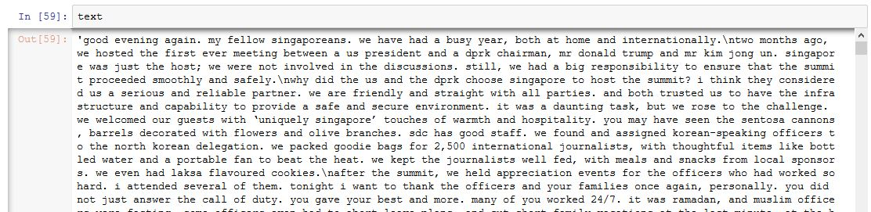
DATA SOURCE and TOOL USED
Tool used for the assignment is ‘Python’
Text for the assignment is of “Singapore National Day Speech” and “article from vox.com about pollution in India”.
Sample Text .

Slide 4
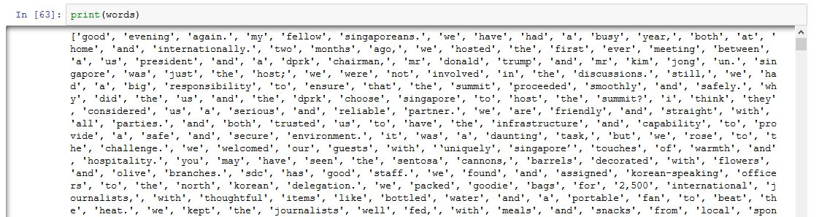
DATA PREPARATION
1.In the given text or data, sentences are broke down to a word and saved as list which are called as ‘Tokens’.
2.Converting all the words to lower case letters (usual practice), known as Normalization.
3. Removal of connecting words from the token which usually does not given any information, this is know as Stop Word Removal.

Slide 5
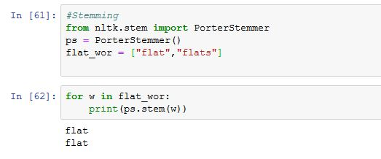
DATA PREPARATION
4.Stemming for words are done.

Slide 6
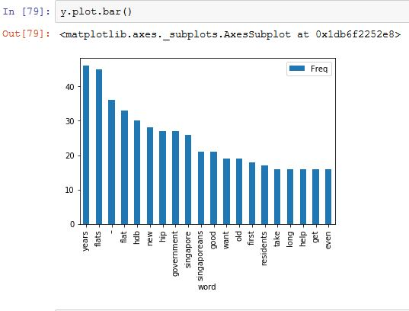
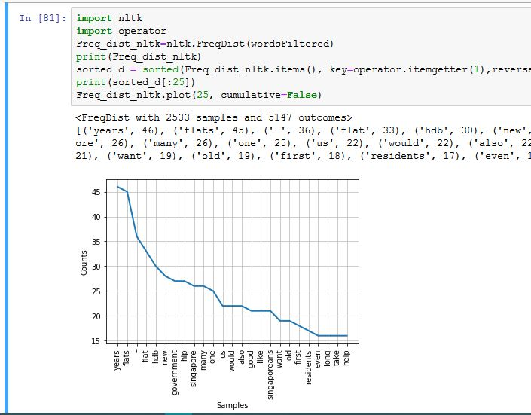
MODELS
Creating Word Frequency Count:
After cleaning the given text by removal of stop words and normalization. Now creating the wordcount frequency and bar graph of the same.

Slide 7
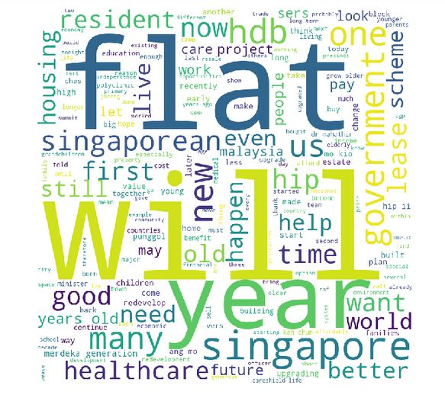
MODELS
Creating Word Cloud:

Slide 8
MERITS OF WORD COUNT AND WORD CLOUD
Word Count:
1.Display relative numbers/proportions of multiple categories.
2. Simple to understand and straightforward to interpret.
Word Cloud:
1.Word Clouds are attractive and easy to create
2.It reveals the essential words like Brand names pop, key words float to the surface

Slide 9
DEMERITS OF WORD COUNT AND WORD CLOUD
Word Count:
Large number of data cannot be displayed at once.
Word Cloud:
1.Its does not give actionable insights.
2.The font size is not everything cause bigger size word not necessarily be important for the business.

Slide 10
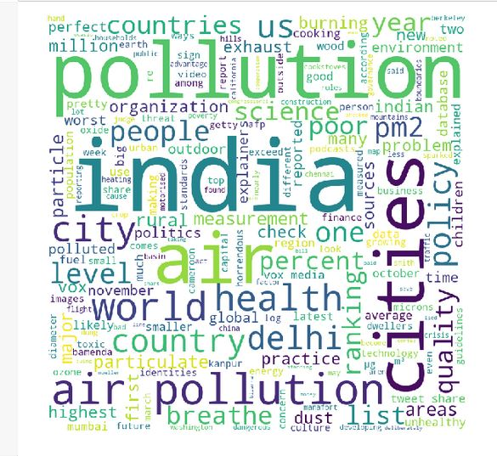
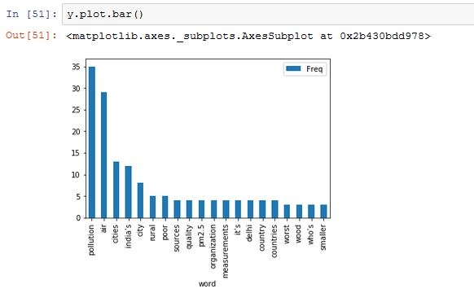
MODELS FOR POLLUTION DATA
Creating Word Frequency Count and word cloud:

Slide 11
GitHub Link:
https://github.com/MalathiMuniraju/hello-world/blob/master/Machine%20Learning%20Assignment.pptx

Slide 12
THANK YOU

